Slide 1
Linear Time-Invariant System Analysis
Response to Arbitrary Signal and Frequency Response

Slide 2
Outline
Purpose
Tool
Method
GUI
Analysis
Demo
Review

Slide 3
Purpose
Linear Time-Invariant System
(A+B)(t)=A(t)+B(t) --Linear
A(t)->B(t) && A(t-1)->B(t-1) --Time-Invariant
Response to Arbitrary Signal
Frequency Response

Slide 4


Tool
IDE
Eclipse IDE for Java Developers
Neon Release (4.6.0)
Programming Language
Java SE Development Kit 8u121

Slide 5

Method
Response to Arbitrary Signal
Convolution : y[n]=(x*h)[n]
Frequency Response
Basic input : x[n]=sin(wn)
Compare with Response y[n]
Amptitude = max(y[n]),n=0,1,2,…,MAX
Phase = w*$∆n$

Slide 6
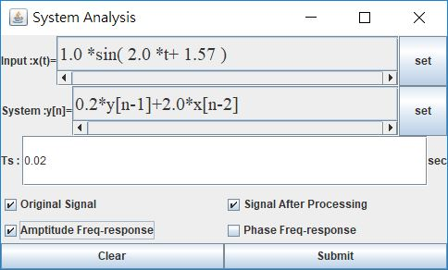
GUI
Input & System state area
Ts setting textfield
Output type setting area
Comfirm area

Slide 7
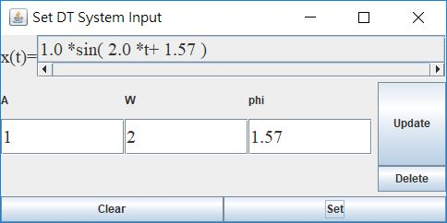
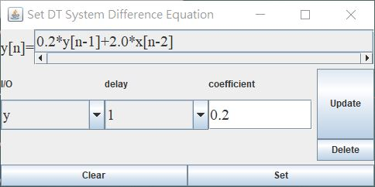
GUI(cont’)

Slide 8
Analysis
High-pass filter
Low-pass filter
Change Ts

Slide 9
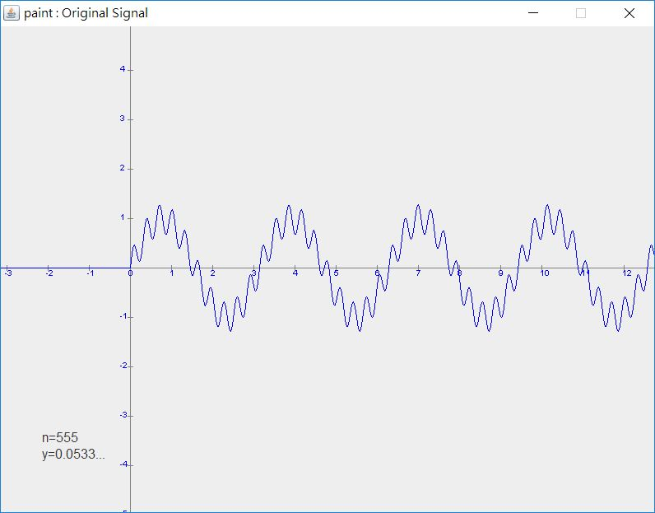
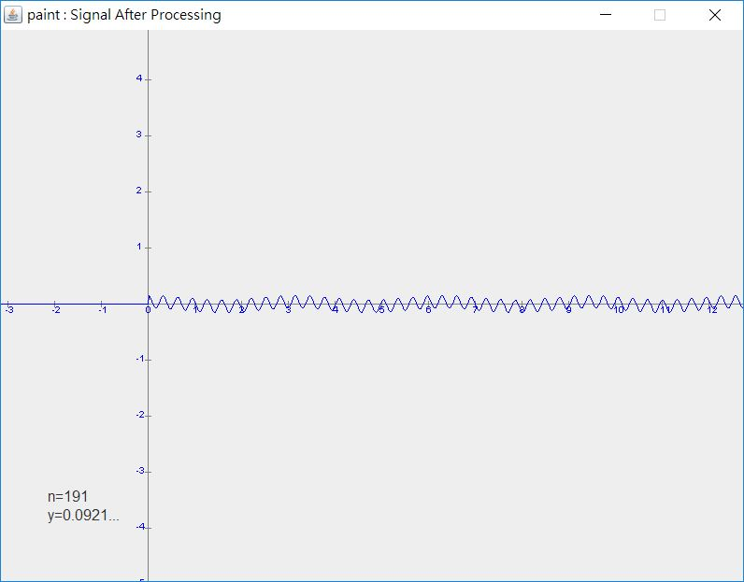
Analysis(cont’)
High-pass filter

Slide 10
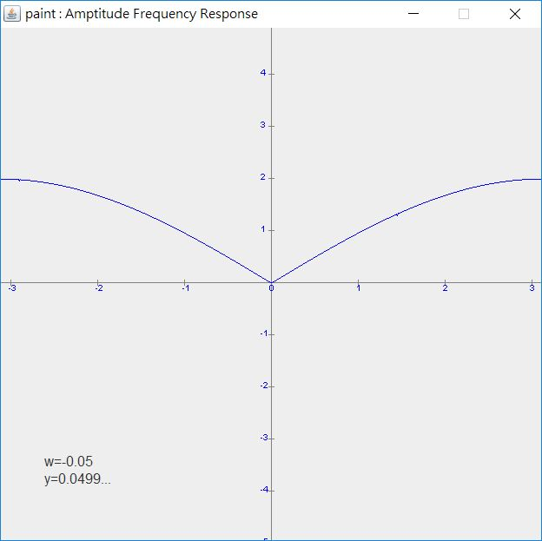
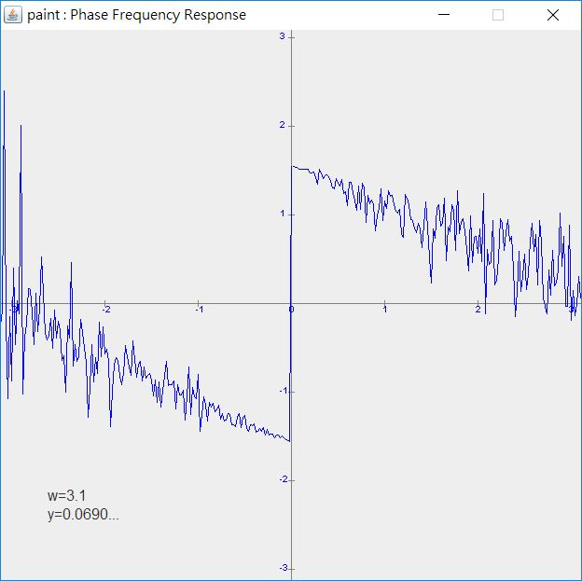
Analysis(cont’)
High-pass filter

Slide 11

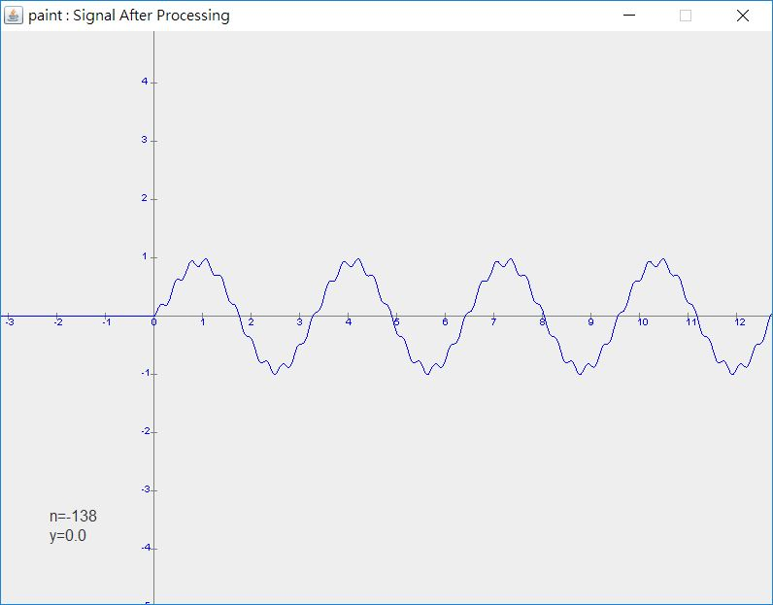
Analysis(cont’)
Low-pass filter

Slide 12
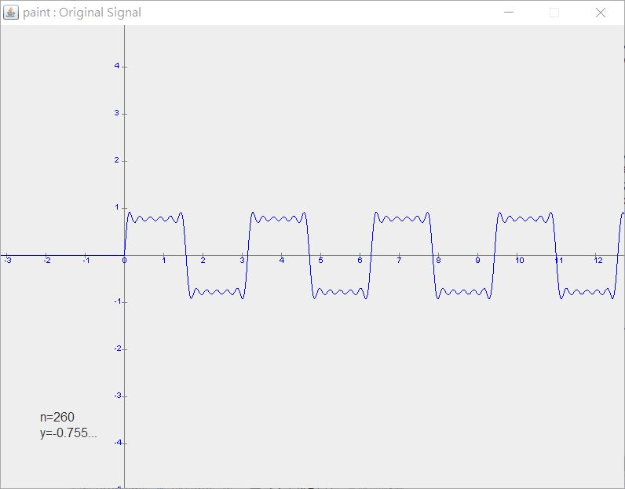
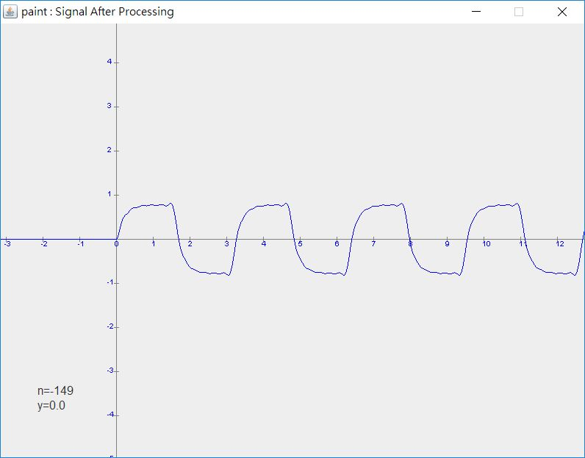
Analysis(cont’)
Low-pass filter

Slide 13
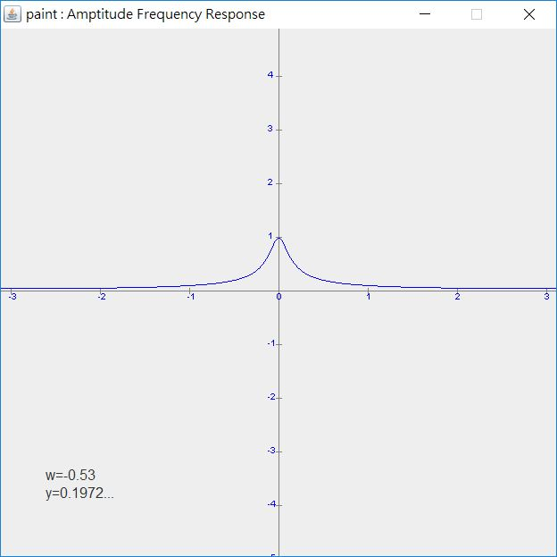
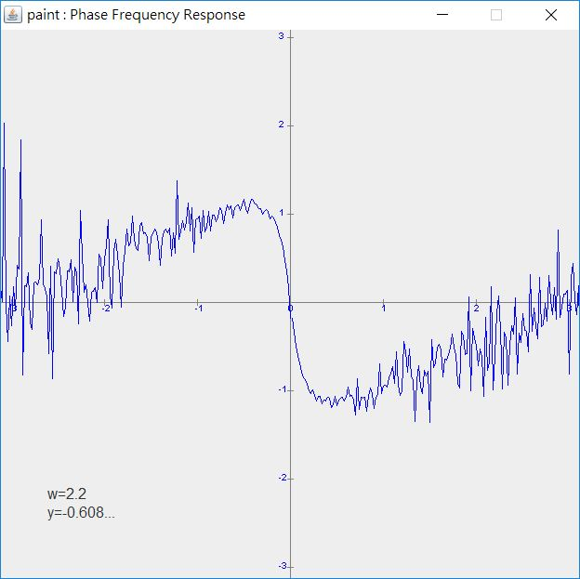
Analysis(cont’)
Low-pass filter

Slide 14
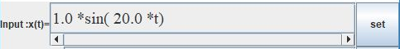
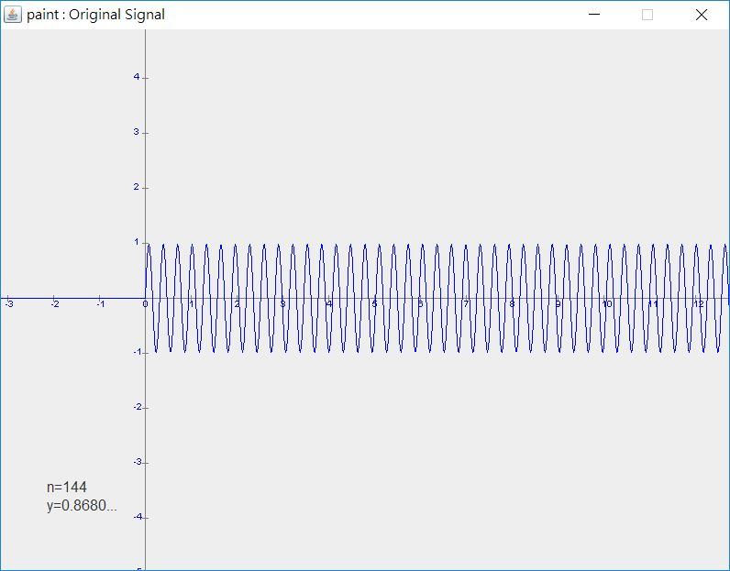
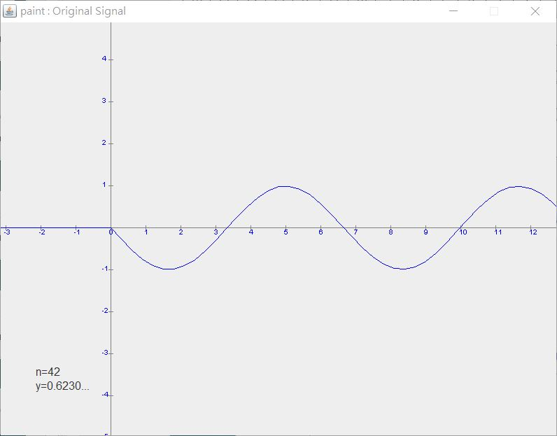
Analysis(cont’)
Ts=0.02
Ts=0.3

Slide 15

Analysis(cont’)
Depend on Nyquist-Shannon sampling theorem
Sampling time < $\frac{1}{2}∙T=\frac{π}{ω}$
Ts<$\frac{π}{20}=0.157$sec

Slide 16
Demo

Slide 17

Review
此次專案製作期間，進一步使用了GUI中較為進階的部分，如：子母視窗切換及傳值等等。使我學習到更多GUI的設計技巧。
此外，計算相位差的部分，在實作時發現因為離散的因素而導致計算上會產生極大的誤差，這點目前可以想到的解決方式，大概僅能依靠$\left|H(z)\right|及$∠$H(z)$，並利用圖形去求出相關數值。
總體來說，藉由此次的專案，不僅能看見波形在各種系統下的變化，還讓我更加了解信號處理的基本過程，使得我受益良多。

